Slide 1
Conditioning Water Using Template Assisted Crystallization to Prevent Scaling in Boilers
Evaluation of an Alternative to Ion Exchange for NAU’s South Boiler and Chiller Plant
A. Alnashwan, M. Alsahali, K. De Silva, F. Yu
Northern Arizona University
CENE 476C
Client- Ellen Vaughn, NAU Office of Sustainability
Technical Advisor- Dr. Terry E. Baxter
Grading Instructor- Dr. Dianne McDonnell
04-26-18

Slide 2
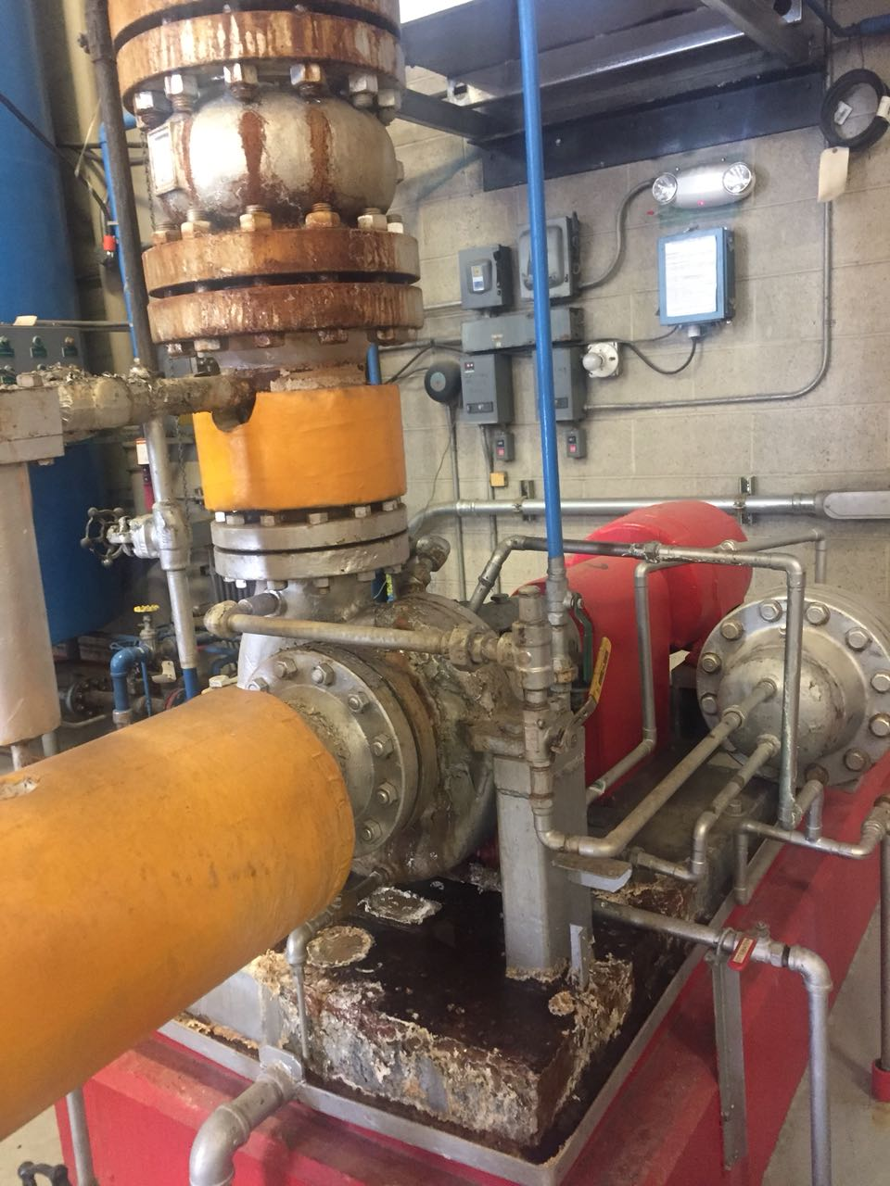
1.0 Project Understanding
1.1 Research Goal:
Testing the prevention of scaling under boiler conditions by using TAC technology.
1.2 Site Location:
Northern Arizona University, South Boiler and Chiller plants.
Figure 1: NAU S Boiler system [1]
De Silva

Slide 3
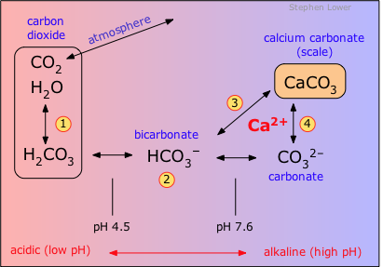
1.0 Project Understanding
1.3 Scale Formation:
Step 1:${ C0}_{2}$ in aqueous solution forms carbonic acid ($H_{2}{CO}_{3}$).
Steps 2-4: At high pH, soluble ${Ca}^{2+}$reacts with ${HCO}^{3−}$and ${CO}_{3}^{2−}$to form an insoluble precipitate (${CaCO}_{3}$).
**Note: At high temperatures, precipitation increases**
Figure 2: Formation of scale [2]
De Silva

Slide 4
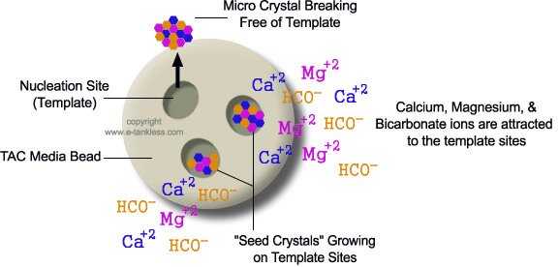
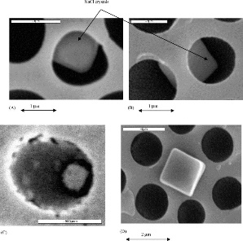
1.0 Project Understanding
1.4 Template Assisted Crystallization (TAC):
(a)
(b)
Figure 3: (a) Template Assisted Crystallization (TAC) technology induces the formation of microscopic calcium carbonate crystals [3], (b) Crystals forming at the nucleation point [4]
De Silva

Slide 5
2.0 Experimental Design
2.1 Hypothesis:
Table 1b: Testing TAC manufacture’s scale prevention claims
Table 1a: Testing TAC manufacture’s scale prevention claims
Manufacturer’s claim | Hypothesis implied and verification
TAC: Dose not reduce water hardness. Scaling prevention ~ 96% efficient. Crystals are nonreactive Crystals remain intact after exposed to high temperature and pressure | TAC: Prevents scaling on pipes system. Visible Crystals remain stable after a long period. Image from Scanning Electron Microscope (SEM) before and after pressure cooker. Water quality testing.
Alnashwan

Slide 6
2.0 Experimental Design
2.2 Design Plan:
Table 2: Research procedures and sampling plan
Criteria
Number of batch flow reactors: | Batches: Batch 1 (1 hour detention tests) Batch 2 (3 hour detention tests) Batch 3 (6 hour detention tests)
Number of samples | 4 samples for each batch test
Alnashwan

Slide 7
2.0 Experimental Design:
Tap Water
TAC Unit
Sampling (${TAP}_{IN}$)
Sampling (${TAC}_{IN}$)
Pressure Cooker 1
Pressure Cooker 2
Sampling (${TAP}_{OUT}$)
Sampling (${TAC}_{OUT}$)
Figure 4: Experimental design setup: flow chart
Alnashwan

Slide 8
3.0 Scope of Work:
3.1 Setting up the apparatus:
3.1.1 Verifying operating capabilities:
Flow rate testing.
3.1.2 Obtaining the unit:
Ex: Fre-Flo, OneFlow, ScaleNet.
3.1.3 Setting up the apparatus:
Obtaining the material needed and setting up the apparatus in the Hydraulics lab.
Alsahali

Slide 9
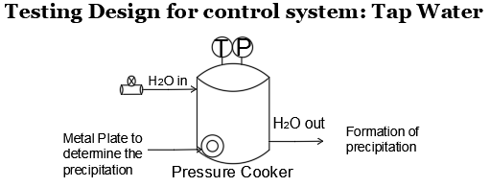
3.0 Scope of Work
3.2 Optimization:
Figure 5: Experimental design control– Hard water (TAP) forms insoluble precipitates (scale) under high temperature (T) and high pressure (P)
Alsahali

Slide 10
3.0 Scope of Work
3.3. Water quality testing:
Table 3: Water quality testing methods for each batch
Testing Parameter | Standard Methods
Hardness of the water | Total Hardness testing-HACH Method 8226 [5]. Calcium Hardness testing- HACH Method 8222[5].
pH of the water | ASTM D1293-18 [6] .
Formation of crystals | Scanning Electron Microscopy (SEM) test.
Formation of scale | The quantity of any scale formed is quantified by dissolution in acid and subsequent analysis.
Alsahali

Slide 11
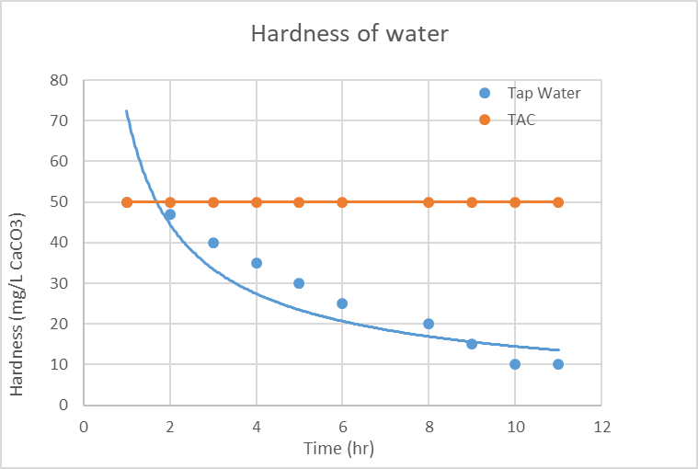
3.0 Scope of Work
3.4. Analysis of results:
3.4.1. Graphical scale comparison
3.4.2. Graphical hardness comparison
Figure 6: Theoretical comparison of hardness
Alsahali

Slide 12
3.0 Scope of Work
3.5. Project Management:
Meetings:
Technical Advisor (TA) Bi-weekly (1-2 hrs.)
Grading Instructor (GI) Bi-weekly (1-2 hrs.)
Client meetings Once every month (1 hr)
Team meetings every weak
3.6. Deliverables:
30% Report
60% Report
Final Report
Website
Final Presentation
Yu

Slide 13
3.0 Scope of Work:
3.7. Project Limitations:
3.7.1. Project Challenges
Simulation of boiler conditions
Coordination with NAU facilities and manufacturers
3.7.2.Project Exclusions
Will only be testing for the hardness, alkalinity, pH, TSS, and scale formation
Will only be testing the feasibility of the TAC unit on South boiler plant
Yu

Slide 14
4.0 Research Schedule:
Table 4: Overall project schedule
Task Name | Start Date | Finish Date
Set up apparatus | 5/30/18 | 6/7/18
Testing (batching) | 6/08/18 | 8/30/18
Water quality testing | 6/08/18 | 8/30/18
Analysis of results | 6/29/18 | 9/18/18
30% proposal | 10/1/18 | 10/1/18
60% proposal | 11/12/18 | 11/12/18
Final presentation | 12/12/18 | 12/12/18
Final proposal | 12/14/18 | 12/14/18
Project management | 6/7/18 | 12/14/18
Meetings | 6/7/18 | 12/13/18
Yu

Slide 15
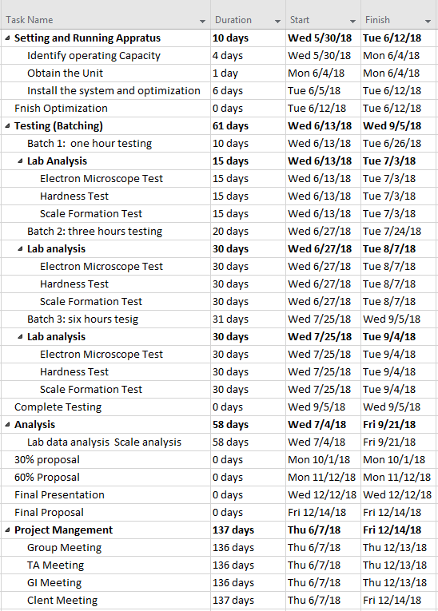
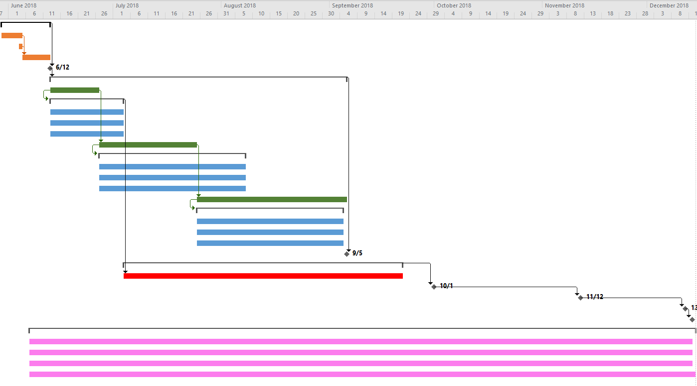
4.0 Research Schedule:
Figure 7: Gantt chart
Yu

Slide 16
5.0 Staffing:
Table 5: Project personnel
Personnel | Code | Rate $/hr
Senior Engineer | SENG | 255
Junior Engineer | JENG | 175
Lab Technician | LT | 103
Research Analyst | RA | 135
De Silva

Slide 17
5.0 Staffing:
Table 6: Staffing plan for the project
Task Name | SENG | JENG | LT | RA
Hours
Setting up the apparatus | 2 | 8 | 4 | 5
Testing (batching) | 15 | 80 | 80 | 30
Water quality testing | 12 | 90 | 105 | 45
Analysis of results | 6 | 15 | 5 | 60
30% proposal | 10 | 10 | 2 | 2
60% proposal | 10 | 10 | 2 | 2
Final proposal | 30 | 20 | 5 | 5
Webpage | 5 | 5 | 2 | 2
Final presentation | 10 | 10 | 3 | 3
Total task hours | 100 | 248 | 208 | 154
Total engineering hours | 710
De Silva

Slide 18
6.0 Cost Analysis:
Table 4: Material and equipment costs
Materials | Quantity | Unit Cost $/hr | Total Cost $
TAC unit | 1 | 600.0 | 600.0
PVC pipes | 3 | 6.95 | 20.85
Pressure cooker | 2 | 1050.0 | 2100.0
pH meter | 1 | 600.0 | 600.0
Sampling containers | 12 | 12.5 | 150.0
Hose | 2 | 10.99 | 21.98
Bucket 5 gal | 1 | 6.21 | 6.21
Timer | 1 | 10.67 | 10.67
Flow meter | 1 | 45.0 | 45.0
Total materials cost |  |  | 3554.71
De Silva

Slide 19
6.0 Cost Analysis:
Table 5: Labor costs and the total billing cost of engineering services
Personnel | Total Hours | Rate $/hr | Multiplier | Total Cost $
SENG | 100 | 255 | 2.43 | 61965.00
JENG | 248 | 175 | 2.03 | 88102.00
LT | 208 | 103 | 2.18 | 46704.32
RA | 154 | 135 | 2.30 | 47817.00
Total labor cost |  |  |  | 244588.32
Total engineering billing cost |  |  |  | 248143.03
De Silva

Slide 20
7.0 References:
[1]“South Heating and Cooling Plant,” Northern Arizona University, Internet: http://library.nau.edu/speccoll/exhibits/louies_legacy/southheating.html [Accessed: 11-Feb-2018]
[2]S. Lower, ‘Hard water and Water Softening,’Dept. of Chemistry, 2018.
[3]"How Template Assisted Crystallization (TAC) Filters Work," Tankless Water Heaters Corp., Internet: https://www.e-tankless.com/how-TAC-works.php [Accessed: 26-Jan-2018]
[4]P. Fox, M. Wiest, T. Thomure, W. Lee, "Evaluation of Alternatives to Domestic Ion Exchange," WateReuse Research Foundation, Tempe, AZ, Rep. 01, 2011.
[5]"National Field Manual," USGS , 2006, pp. 10-130.
[6]HACH, HACH Water Analysis Handbook, Loveland, CO, U.S.A., HACH Company, 2003.
[7]M. Corridan, “Fre-Flow, Solutions for water Conditioning”, Fre-Flow™, Personnel Communications-Email, 2018.
[8]]"CE Center - Template-Assisted Crystallization." Continuingeducation.bnpmedia.com, 2018. Internet: https://continuingeducation.bnpmedia.com/courses/multi-aia/templateassisted-crystallization/ [Accessed: 25-Feb-2018]
[9]"Mcgraw Hill Continuing Education – Template Assisted Crystallization." Greg Reyneke, 2012. Internet: http://gregknowswater.com/mcgraw-hill-continuing-education-template-assisted-crystallization/ [Accessed: 25-Feb-2018]
[10]W. S. Miller, "Understanding Ion-Exchange for water treatment system," GE water and process Technologies, vol. 35, no. 8, pp. 149-153, 2018.
[11]M. K. Ahn, C. Han, "Technologies for the Removal of Water Hardness and Scaling Prevention," Journal of Energy Engineering, vol. 26, no. 2, pp. 73-79, 2017
[12]J. Heitzinger, E. Vaughan, “NAU chiller/boiler information”, Personnel Communications-Email, 2018.

Slide 21
QUESTIONS?

